Slide 1
Selecting Writing Approach
When ever you are writing a message, properly assess the reader’s reaction;
  If the reaction is negative, indirect order is your likely choice
  If it is positive or neutral, you probably will want directness
Ch. 9, Slide <number>

Slide 2
Goals in Communicating
Bad/Negative News
To make the reader understand and accept the bad news
To promote and maintain a good image of the writer and the writer’s organization
To make the message so clear that additional correspondence is unnecessary

Slide 3
The Indirect Pattern
Buffer

Slide 4
The Indirect Pattern
Buffer
Reasons

Slide 5
The Indirect Pattern
Buffer
Reasons
Bad News

Slide 6
The Indirect Pattern
Buffer
Reasons
Bad News
Close

Slide 7
The Indirect Pattern
BUFFER – a neutral or positive opening that does not reveal the bad news
REASONS – an explanation of the causes for the bad news
BAD NEWS – a clear but understated announcement of the bad news that may include an alternative or compromise
CLOSE – a personalizing, forward-looking, pleasant statement

Slide 8
Brief Review of a Procedure for a Refused Request
Preliminary considerations:
The news is bad.
The reader wants something; you must refuse.
Your goals are:
  to say no, and
  to maintain goodwill.
The first goal is easy; the second requires tact.
You must present reasons that will convince.

Slide 9

Refusing Routine Requests

Slide 10
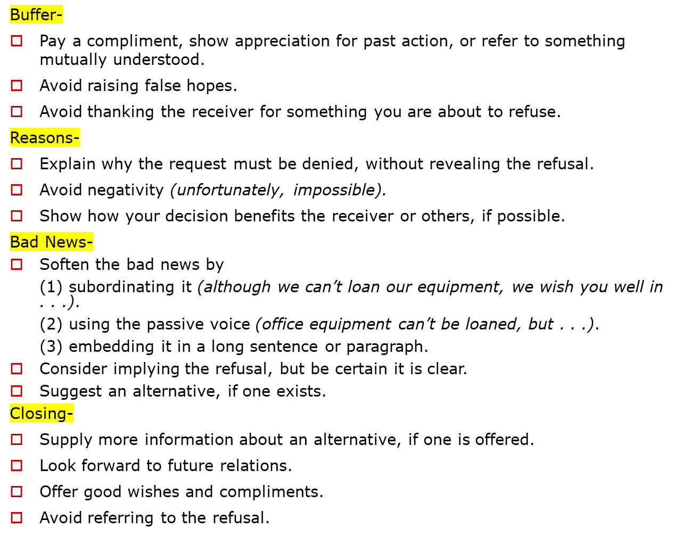

Slide 11
Buffer
Pay a compliment, show appreciation for past action, or refer to something mutually understood.
Avoid raising false hopes.
Avoid thanking the receiver for something you are about to refuse.

Slide 12
Reasons
Explain why the request must be denied, without revealing the refusal.
Avoid negativity (unfortunately, impossible).
Show how your decision benefits the receiver or others, if possible.

Slide 13
Bad News
Soften the bad news by
(1) subordinating it (although we can’t loan our equipment, we wish you well in . . .).
(2) using the passive voice (office equipment can’t be loaned, but . . .).
(3) embedding it in a long sentence or paragraph.
Consider implying the refusal, but be certain it is clear.
Suggest an alternative, if one exists.

Slide 14
Close
Supply more information about an alternative, if one is offered.
Look forward to future relations.
Offer good wishes and compliments.
Avoid referring to the refusal.

Slide 15

Larry_Bragg@callawaygolf.com
Request for alumni information
Mr. Bragg,
Your study of the progress of State University graduates is most commendable. We are pleased that you would ask our help in your efforts.
In reviewing the requirements of your project, we find that it would be necessary to search through the personnel files of each of our 10,000 employees. As our regular staff is already working at capacity, may we suggest that we make our files available to you or your representatives? We ask only that you protect the confidentially of the information in the files. We would be pleased to give you working space in the records center. And we would assure you of the cooperation and assistance of our records personnel.
As another alternative, may we suggest that you use a part-time student worker who is already acquainted with our files. From time to time, Ms. Mary Mahoney has worked in

Slide 16
Larry_Bragg@callawaygolf.com
Request for alumni information
center. And we would assure you of the cooperation and assistance of our records personnel.
As another alternative, may we suggest that you use a part-time student worker who is already acquainted with our file system. From time to time, Ms. Mary Mahoney has worked in our file center. We estimate that she could do your work in about five weeks, working her customary twenty hours a week. The cost would be about $900. If you prefer this arrangement, we would be pleased to contact her for you.
We expect that these suggestions will help you in completing your project. We look forward to reading the results in the Alumni Bulletin.
Terry

Slide 17

Improved Customer Request Refusal
“After” Version
Notes:
43

Slide 18
Customer Request Refusal: “After” Version
Dear Mr. Waters:
We’re happy to learn that you are enjoying the use of the Sako copier you’ve been leasing for the past ten months. Like our many other customers, you have discovered that Sako copiers offer remarkable versatility and reliability.
One of the reasons we’re able to offer these outstanding copiers at such low leasing rates and equally low purchase prices is that we maintain a slim profit margin. If our program included a provision for applying lease payments toward the purchase price, our overall prices would have to be higher. Although lease payments cannot be credited toward purchase price, we can offer you other Sako models

Slide 19
Customer Request Refusal: “After” Version
that are within your price range. The Sako 400 delivers the same reliability with nearly as many features as the Sako 600.
Please let us demonstrate the Sako 400 to your staff in your office, Mr. Waters. Our representative, Tracy Wilson, will call you soon to arrange a time if it does for you.
Sincerely,

Slide 20
Preliminary Considerations in Writing Adjustment Refusals (1 of 2)
The decision has been made to refuse an unjustified claim.
The news is bad.
The goal is to present the bad news in a positive way.
Thus, you must think through the situation to develop a strategy to explain or justify the decision.

Slide 21
Brief Review of Procedure for Adjustment Refusals (2 of 2)
Opening
Begin with words that
  are off subject,
  are neutral, and
  set up the message.
Present the strategy that will explain or justify.
Make it factual and positive.
Lead systematically to the refusal.
Then refuse--clearly and positively.
End with off-subject, friendly words.
Body
Closing

Slide 22
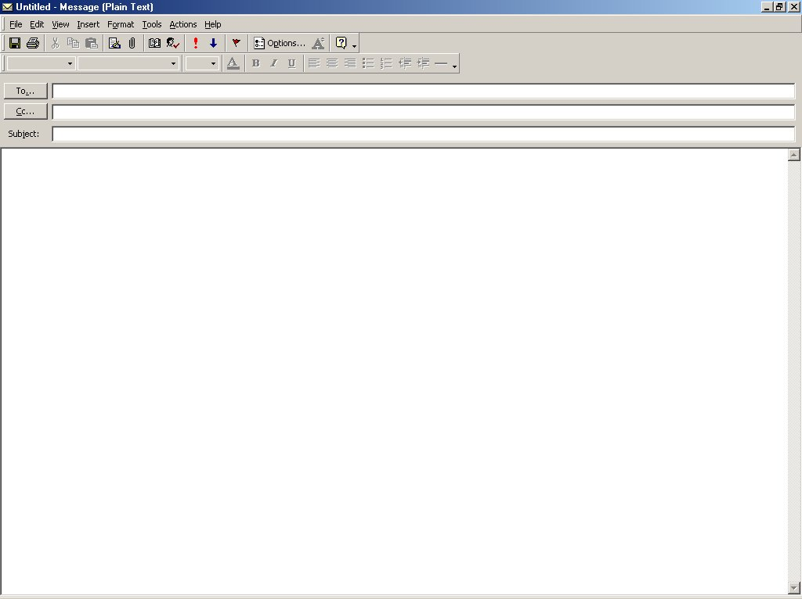
Jason Mertz
Payment on Invoice C2005
Mr. Mertz:
Thank you for your check for $945.07 on Invoice C 2005.
Although it is a small matter, I feel that you will want to look over this invoice. Probably you just looked at the wrong column, but you will see that you wrote the check for the amount less the discount. As you know, the discount is allowed only when payment is made within ten days of billing. As Invoice C2005 is now 45 days past this date, we are crediting your account with $945.07, leaving an unpaid balance of $29.23. I am confident you will understand.
Working with you and your excellent organization, Mr. Mertz, is always a pleasure. We look forward to serving you again real soon.
Ray Rojas

Slide 23
rjluce@uniquesupplies.com
Special paneling concern
Mr. Luce,
Certainly we understand your concern expressed in your May 11 letter about getting just the right material for your new office building. We share this concern with you. And we are determined to do our part about it.
To see whether we have done our part about your special paneling, we reviewed the facts of the case. We find that your architect specified a most unusual and distinctive finish. His specifications were in careful detail, and we followed them to the letter. Although the finished paneling is genuinely beautiful, it is unique and could not go into our regular stock. For this reason, we feel that any adjustment in this case must be between you and your architect. I am confident that you will see the justice in our decision.
We are grateful for the role we have played in constructing your distinctive building.

Slide 24
rjluce@uniquesupplies.com
Special paneling concern
be between you and your architect. I am confident that you will see the justice in our decision.
We are grateful for the role we have played in constructing your distinctive building. We stand ready to meet your future needs to the letter.
Dominic Terrado

Slide 25
Brief Review of Procedure for
Credit Refusals (2 of 2)
Opening
Begin with words that
  are neutral, and
  tie in with document being answered.
  set up the strategy (explanation).
Present the explanation and/or justification.
As a logical follow-up--refuse tactfully.
  If to a bad moral risk, may be by implication.
  If to one with weak finances,
    should refuse positively, and
    look hopefully to the future.
Close with goodwill words that fit the one case and are friendly and forward-looking.
Body
Closing

Slide 26
Tact in a Credit Refusal (1 of 3)
Opening
Dear Ms. Jessy:
We are really pleased to know that your company liked our product sample and appreciate your March 29 order for the products. The statements, trade references, and explanations accompanying the order were really helpful to assess your request.
Click to view full letter at once.

Slide 27
Tact in a Credit Refusal (2 of 3)
Body
In checking over them, we find that you have an unusually heavy burden of invoices to pay within the next few months. As we see it, burdening you with more bills to pay at this time simply would not make good business sense. Thus, we can sell to you only for cash now. By buying for cash and taking advantage of the cash discount, you would be taking a sound step toward improving the financial health of your business. Just as soon as your situation is improved, we shall open your account.

Slide 28
Tact in a Credit Refusal (3 of 3)
Closing
We look forward to receiving your check for $730.69 ($745.60 less the $14.91 discount). When we get it, we’ll rush your merchandise to you.
Sincerely,
Susan Yassine
Susan Yassine

Slide 29
“ To speak kindly does not hurt the tongue.”
--Unknown

Slide 30

Writing Routine, Good-News and Goodwill Messages
Directness is likely choice

Slide 31
The Direct Pattern
Begin with the objective (Tell immediately why you are writing)
Explain in the body
Be specific and courteous in the closing.
Ch. 9, Slide <number>

Slide 32
Routine, Good-News and Goodwill Messages Includes-
Routine requests:
  Asking for information, action, products, making claims and requesting adjustments, requesting recommendations and references, placing orders
Routine Responses:
  Sending informative messages, granting requests for information and action, granting claims and requests for adjustments, providing recommendations and references
Ch. 9, Slide <number>

Slide 33
Routine, Good-News and Goodwill Messages Includes (Contd.)-
Announcing Good News:
  About employment, about products and operations
Sending Goodwill Messages:
  Congratulations, Message of Appreciation
Ch. 9, Slide <number>

Slide 34

Requesting Information and Action
Ch. 9, Slide <number>

Slide 35
Opening
Routine requests begin asking a question or issue with a polite command (Will you please supply me with information about the products you supply. )---No question mark.
Ch. 9, Slide <number>

Slide 36
Body
Include necessary information whenever fits (explain your purpose and provide details)
If a number of questions are involved, ask them. Make the questions stand out (using bullet, numbering, paragraphing)
Express questions in parallel form.
To elicit the most information, use open-ended questions (What training programs do you recommend?) rather than yes-or-no questions (Are training programs available?).
Suggest reader benefits, if possible.
Ch. 9, Slide <number>

Slide 37
Closing
State specifically, but courteously, the action you wish to be taken (We will appreciate having your answers for our October 3 staff meeting).
Set an end date, if one is significant, and explain why.
Avoid cliché endings (Thank you in advance for your cooperation). Show appreciation but use a fresh expression (We would appreciate hearing from you this week. You can reach me by calling 989 during business hours.
Make it easy for the receiver to respond.
Ch. 9, Slide <number>

Slide 38
Routine Inquiry--Good Example
Dear Mr. Robin:
Will you please help us to serve you better by answering the following questions.
When you returned merchandise at our store recently:
1. Were you served promptly and courteously?
2. Was the adjustment satisfactory and in accordance with your wishes?
3. Did the salesperson offer to assist you in selecting other merchandise?
Please write your answers--and any other comments you may wish to make about the service of this store and any other HRTex store--on this letter. Then return it in the enclosed stamped and addressed envelope.
We shall be most grateful for your help.
Sincerely,
Ch. 9, Slide <number>

Slide 39

Routine Request
“Before” Version
Ch. 9, Slide <number>

Slide 40
Routine Request: “Before” Version
Dear Sir:
Because we are one of the largest banking systems in the country, we receive hundreds of résumés from job candidates every day. We need help in sorting and ranking candidates by categories, such as job classification, education, work history, skill, and experience.
Recently, I was reading WORKFORCE magazine, and the March issue has a story about your new software program called Resumix. It sounds fascinating and may be the answer to our problem. We would like more information about this program, which is supposed to read and sort résumés.
Ch. 9, Slide <number>

Slide 41
Routine Request: “Before” Version
In addition to learning if the program can sort candidates into the categories mentioned earlier, I’m wondering if the program can read all the different typefonts and formats that candidates use on their résumés. Another important consideration for us is training and troubleshooting. If we need help with the program, would you supply it?
Thank you for your cooperation.
Sincerely,
Ch. 9, Slide <number>

Slide 42
Routine Request
“After” Version
Ch. 9, Slide <number>

Slide 43
Routine Request: “After” Version
Dear Product Manager:
Please send me information about your Resumix software program, which I read about in the March issue of WORKFORCE magazine.
We receive hundreds of résumés daily, and, frankly, we need assistance in processing them. Answers to the following questions would help us determine if Resumix could solve our problem.
1. In terms of fonts and formats, what kinds of résumés can your software read?
2. Can the program help us sort and rank candidates by
Ch. 9, Slide <number>

Slide 44
Routine Request: “After” Version
categories such as job classification, education, work history, skill, and experience?
3. How does your company provide training and troubleshooting service for your software?
I would appreciate your response by April 1 so that we can study the program before the rush of job applications in June.
Sincerely,
Ch. 9, Slide <number>

Slide 45

Routine Claim Letters
Ch. 9, Slide <number>

Slide 46
Preliminary Considerations in Writing a Claim Letter
A product or service has given you a problem.
  You are in the right.
  Probably the offending company will want to correct the matter.
  You want to make a strong claim.
These three facts of the case support directness.
Ch. 9, Slide <number>

Slide 47
Directness for a Claim Letter
Opening
Begin directly. Tell what is wrong and what you want.
Explain the facts—enough to permit a decision. Clarify the problem and justify your request.
Seek corrective action, either by
  stating what you want, or
  letting the reader decide what to do.
Include names of individuals and dates of previous actions.
End positively—on a friendly but firm note.
Note: Act promptly in making claims, and keep a copy of your message.
Body
Closing
Ch. 9, Slide <number>

Slide 48

[Helen Toohey, 09:17 AM 9/17/2005 –0800, Wrong billing of shipment under Invoice X13771]
Ms. Jessy:
Subject : Wrong billing of shipment under Invoice X13771
From your invoice of August 7, I see that you have sent my gifts COD. I need your friendly help in restoring face.
Please refer to my original order of July 31 (copy attached) to see that the Butterfly jewel box for Ms. Chowdhury and the Piper smoking jacket for Mr. Robin Chowdhury were clearly specified for prepaid shipment. You were to include the bill for these items in the COD shipment of the Black Diamond desk sent to me.
Please correct this embarrassing error right away. I ask that you write each of the recipients of my gifts, refunding their money and explaining what happened. Then send copies of your letters and the total bill to me.
You have my grateful thanks for putting me back in the good graces of the Chowdhury.
Rocky
ORDER731.DOC
Ch. 9, Slide <number>

Slide 49
Inquiries About People
They are a special form of routine inquiry.
They involve two differences:
  Need to respect human rights
  Need to structure around the one job
Ch. 9, Slide <number>

Slide 50
Dear Mr. Bateman:
Subject: Request for some information about Ms. Alice Barron
Will you please assist me in evaluating Ms. Alice Barron for work as a district sales manager with us. In her application Ms. Barron indicated that she worked for you as a salesperson from early 2001 to 2005. She has authorized this inquiry.
The work for which we are considering Ms. Barron involves supervision a staff of four salespeople plus an office staff of two. While with you, did Ms. Barron show the leadership ability such an assignment requires?
As a manger, Ms. Barron would need to know administration. She would be responsible for running the business end of an office. Do you feel she has the necessary knowledge and ability?
Ms. Barron would also be responsible for managing the sales efforts in her district--activities like setting quotas, working out itineraries, evaluating performance, and coordinating and
Ch. 9, Slide <number>

Slide 51
Ms. Barron would also be responsible for managing the sales efforts in her district--activities like setting quotas, working out itineraries, evaluating performance, and coordinating and stimulating sales efforts. Does she have the ability to do these things?
In addition to the managerial duties, Ms. Barron would spend some time selling Kopy Kat equipment. This is hard selling--and it requires an aggressive, personable, hardworking person. Does Ms. Barron meet this requirement?
Both Ms. Barron and I will appreciate your candid replies to these questions, plus any other information you feel we should have. Of course, I will hold your comments in strict confidence.
Janet Baker, Manager
Human Resources Department
Ch. 9, Slide <number>

Slide 52

Order Letters
Ch. 9, Slide <number>

Slide 53
Opening
Use order language to identify the message (Please send by UPS the following items from your spring catalog).
Name the information source (the May 2 advertisement in the Daily News).
Ch. 9, Slide <number>

Slide 54
Body
List items vertically.
Provide quantity, order number, complete description, unit price, and total price.
Prevent mistakes by providing as much information as possible.
Ch. 9, Slide <number>

Slide 55
Closing
Tell how you plan to pay for the merchandise.
Tell when you would like to receive the goods, and supply any special instructions.
Express appreciation.
Ch. 9, Slide <number>

Slide 56

Direct Reply Letters
Ch. 9, Slide <number>

Slide 57
Directness for a Favorable Response
Begin with the answer or state you are complying with the request.
Identify the message being answered--incidentally in the beginning or in a subject line.
Continue to give what is wanted in an orderly arrangement.
If negative information is involved, give it proper emphasis. Consider including extras.
End with friendly, adapted words.
Opening
Body
Closing
Ch. 9, Slide <number>

Slide 58

Answering a request/action
Ch. 9, Slide <number>

Slide 59
Mr. Andrews:
Subject: Manufacturers’ Directory Assistance
Yes, sir, we’ll gladly help with your manufacturers’ directory, just as you have asked in your April 12 message.
To get the names and classifications up to the “directory” exactness, Mr. Stanley McLaughlin, of our own directory staff, has already started a by-name check of each listed industry. He will label carefully the exact goods produced or processed; and he will mark the sales agents as such. You can expect his report by the 20th, I’m sure.
Your completed online directory will certainly help Louisiana industry get a measure of itself and will help to “sell” Louisiana as a ripe field for many types of new enterprises. It’s a fine job you are taking on. We’ll be glad to see the finished product.
Lisa Brown
Ch. 9, Slide <number>

Slide 60
Granting Claims
Ch. 9, Slide <number>

Slide 61
Granting Claims
Opening
When approving a customer’s claim, announce the good news immediately.
Avoid sounding grudging or reluctant.
Body
Strive to win back the customer’s confidence; consider explaining what went wrong (if you know).
Concentrate on how diligently your organization works to avoid disappointing customers.
Be careful about admitting responsibility; check with your boss or legal counsel first.
Avoid negative language (trouble, neglect, fault).
Don’t blame customers – even if they are at fault.
Don’t blame individuals or departments in your organization.
Don’t make unrealistic promises.
Ch. 9, Slide <number>

Slide 62
Granting Claims (Contd.)
Show appreciation that the customer wrote.
Extend thanks for past business.
Refer to your desire to be of service.
Closing
Ch. 9, Slide <number>

Slide 63
[Albert T. Hamm, 07:12 PM 6/20/2005 –0800, Full credit for suit from Consort]
Mr. McShane:
Subject: Full credit for suit from Consort
Crediting your account for $321.40 is Consort’s way of assuring you that your satisfaction is very important to us.
Because we sincerely want to please, we thoroughly examined the suit you returned to us. Our investigation showed that the likely cause of the fading was accidental contact with some form of chemical. We couldn’t determine precisely what the chemical was or just how contact was made. But we suspect a liquid spill sometime after packaging, either in our warehouse or during shipment. Such unexpected happenings will occur in spite of our best precautions. Anyway, we were relieved to know that Consort’s reputation for quality fabrics and craftsmanship remains good.
We want you to know that we sincerely desire to serve you. And we look forward to serving you with high-quality Consort suits in the years ahead.
Albert T. Hamm, Manager
Consumer Relations
Ch. 9, Slide <number>
Full credit from…

Slide 64

Letters of Recommendation
Ch. 9, Slide <number>

Slide 65
Opening
Name the candidate and position sought.
State that your remarks are confidential.
Describe your relationship with the candidate.
Ch. 9, Slide <number>

Slide 66
Body
Describe the applicant’s performance and potential.
Strive to include statements about communication skills, organizational skills, people skills, ability to work with a team, etc.
Include definite, task-related descriptions (She completed two 50-page proposals instead of She works hard).
Ch. 9, Slide <number>

Slide 67
Body
Include negative statements only if they are objective and supported by facts.
Ch. 9, Slide <number>

Slide 68
Closing
If supportive, summarize candidate’s best points.
Offer ranking of candidate (Of all the accountants I have supervised, she ranks in the top 10 percent).
Offer to supply additional information if needed.
Ch. 9, Slide <number>

Slide 69
[Chris Woods, 09:11 AM 4/9/2005 –0800, Confidential report on Ms. Cindy Commons, requested July 2]
Mr. Villas:
Subject: Confidential report on Ms. Alice Barron, requested July 2
From December 2002 through February 2005, Ms. Barron worked for Central Grocery, Inc., under my direction. She left us for employment in her hometown. We would welcome her back. While she was with us, she served first as a stock clerk, later as a checkout cashier, and for the last year as my assistant. During this time she learned all aspects of the grocery business. In my judgment, she has the experience and knowledge needed for the job she seeks.
I feel, also, that Ms. Barron has the personal qualities the job requires. She is mature, stable, and personable. She has strong convictions and expresses them firmly--sometimes at the expense of harmony within the work group. But she is also sincere and open-minded. As far as I know, her morals are exemplary.
Ch. 9, Slide <number>
Confidential …

Slide 70
[Chris Woods, 09:11 AM 4/9/2005 –0800, Confidential report on Ms. Cindy Commons, requested July 2]
Confidential report on Ms. Cindy Commons, requested July 2
Answering your question about Ms. Barron’s leadership ability is somewhat difficult for her work with us was primarily in a subordinate position. But from what I have observed, I feel that she has good leadership potential. She appears to like people and to have a genuine concern for them. And she appears to have other characteristics of good leadership--a sense of fairness, good communication ability, loyalty, and dedication to work.
In summary, I feel that Ms. Barron is well qualified for the work she seeks. I would not hesitate to put her in a similar position in this company.
If I can help you further in your evaluation Ms. Barron, please write me again.
Christopher Woods, Manager
Human Resources
Central Grocery
Ch. 9, Slide <number>
Confidential …

Slide 71
Directness for an Order Acknowledgment
Opening
Give the status of order.
Include some goodwill—acknowledging incidentally, reselling, sales talk, or such.
Include a “thank you.”
If there is a problem (vague order, back order)--
  Some businesses report frankly, assuming some problems are expected.
  Others prefer to use tactful approach to get needed information on vague orders, or report back orders.
Close with adapted, friendly words.
Body
Closing
Ch. 9, Slide <number>

Slide 72
[Krystal Benko, 03:17 PM 8/3/2005 –0800, Trevor Hardware Order Confirmation]
Mr. Cotton:
Subject: Trevor Hardware Order Confirmation
By the time you receive this letter, you should have received the assorted pipe you ordered July 15. As you requested we shipped it by Zephyr Freight, and we will bill you on the first.
As you may know, the J-4 Kotter Pipe Joint Clamps have been a very popular item recently. We have marked these clamps for rush shipment to you just as soon as our supplies are replenished. Our plant foreman tells me that his people are working overtime to catch up. He promises that we will have the clamps on the way to you no later than August 12.
Thank you for giving us another opportunity to serve you with quality Kotter products.
Krystal Benko
Office Manager
Ch. 9, Slide <number>
Trevor Hardware…

Slide 73
End
Ch. 9, Slide <number>

